Slide 1

Lecture
on
“Advanced Computer Architecture –TCS 704”
by
Akansha Gupta
DEPARTMENT OF COMPUTER SCIENCE AND ENGINEERING
GRAPHIC ERA DEEMED TO BE UNIVERSITY – 248002

Slide 2
• What is Architecture? • What is “Computer Architecture” • Why Computer Architecture • Forces on Computer Architecture • Growth in Processor Performance • Changing Face of Computing • Depends On The Class Of Processor

Slide 3
WHAT IS ARCHITECTURE?
• Original sense: – Taking a range of building materials, putting together in desirable ways to achieve a building suited to its purpose
• In Computer Science: – Similar: how parts are put together to achieve some overall goal – Examples: the architecture of a chip, of the Internet, of an enterprise database system, an email system, a cable TV distribution system

Slide 4
What is “Computer Architecture”?
Application
Operating
System
Compiler
Firmware
Instruction Set
Architecture
Instr. Set Proc.
I/O system
Datapath & Control
Digital Design
Circuit Design
Layout
Coordination of many levels of abstraction
Under a rapidly changing set of forces
Design, Measurement, and Evaluation

Slide 5
WHY COMPUTER ARCHITECTURE?
Exploit advances in technology
Make things Faster, Smaller, Cheaper, …
Which enables new applications
Shrek 20 years ago?
Make new things possible
Accurate one-month weather forecasts? Cure for cancer? Life-like virtual reality?
The advancement of computer architecture is vital for the advancement of all other areas of computing!

Slide 6
Forces on Computer Architecture
Technology
Programming
Languages
Applications
Computer
Architecture
Operating
Systems
History
(A = F / M)

Slide 7
DIFFERENCE BETWEEN COMPUTER ARCHITECTURE AND COMPUTER ORGANIZATION

Slide 8
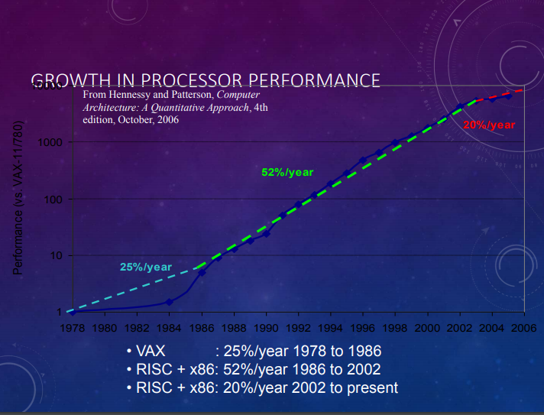

Slide 9
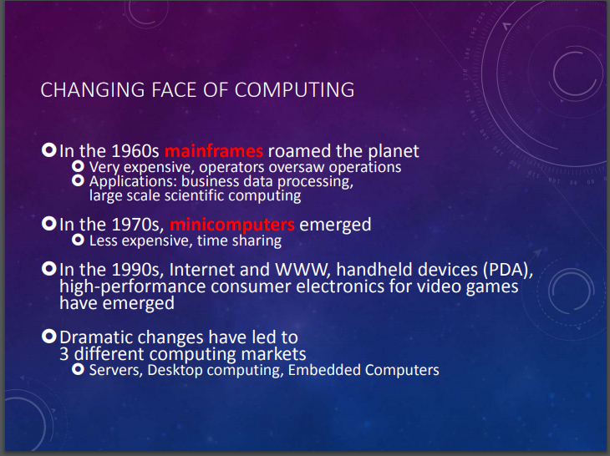

Slide 10
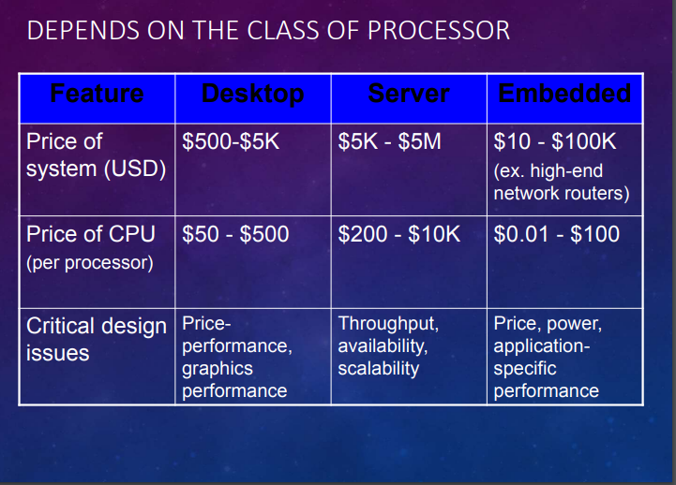

Slide 11
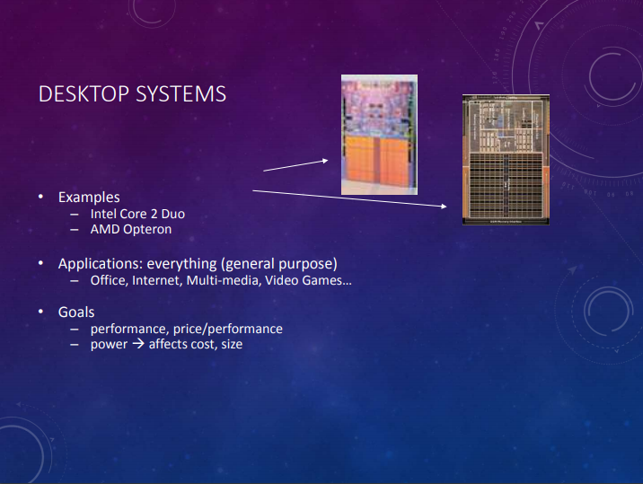

Slide 12
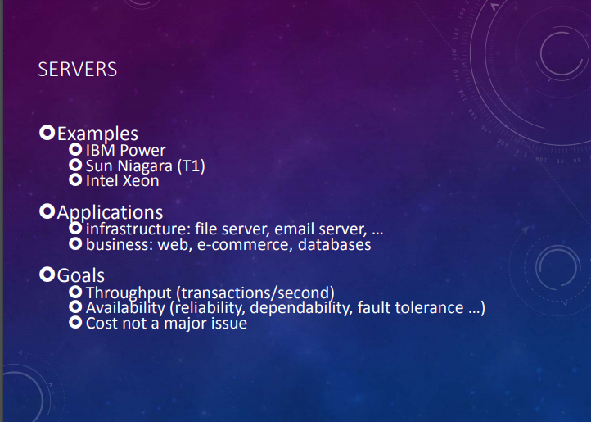

Slide 13
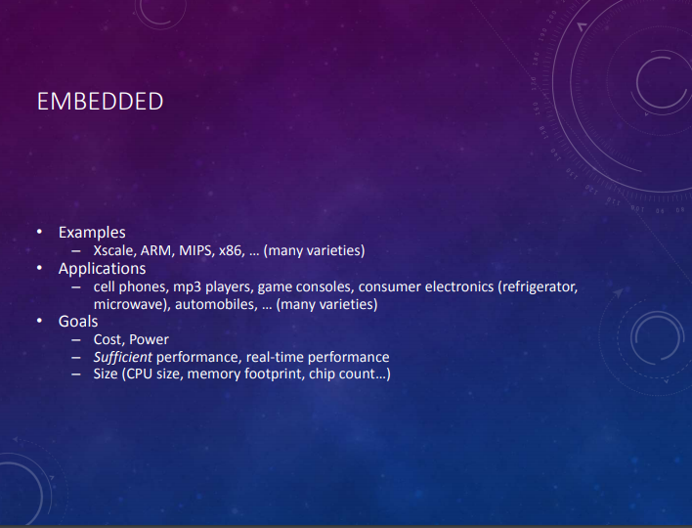

Slide 14
thanks
https://youtu.be/sboeCriiy_M

